Slide 1
Atliq hardware (SQL sales insight from aD-hoc requests)
Sagar Soni

Slide 2
CONTENTS
Ad-Hoc Request
SQL Query
Output
Get Insight

Slide 3
INTRODUCTION
Atliq Hardware (imaginary company) is one of the leading computer hardware producers in India and has expanded in other countries too.
However, the management noticed they do not get enough insights to make quick, smart data-informed decisions. They want to expand their data analytics team by adding several junior data analysts.

Slide 4
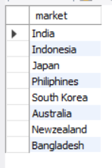
10 Ad – Hoc Requests
1. Provide the list of market in which customer “AtliQ Exclusive” operates its business in the APAC region.
SQL Query
SELECT distinct market FROM dim_customer
WHERE customer = "Atliq Exclusive" and region = "APAC"
Output

Slide 5
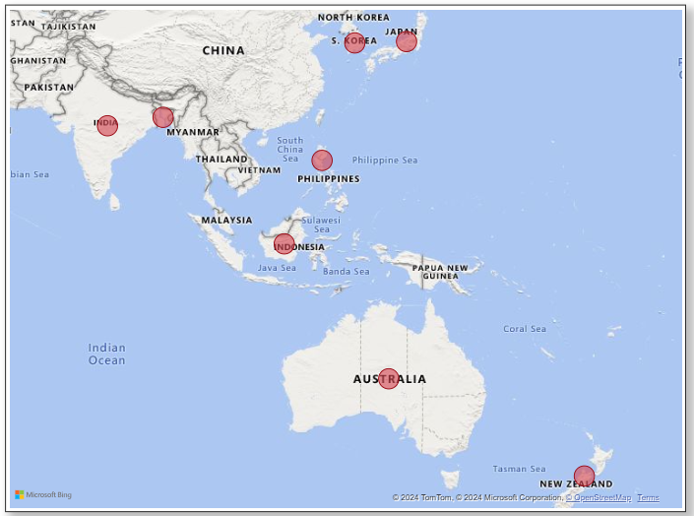
1. Provide the list of market in which customer “AtliQ Exclusive” operates its business in the APAC region.
AtliQ Exclusive operates in the following markets in the Asia-Pacific region.

Slide 6

2. What is the percentage of unique product increase in 2021 vs 2020? The final output contains these fields.
1) unique_product_2020 2) unique_product_2021 3) Percentage_chg
SQL Query
WITH cte1 AS(
SELECT COUNT(distinct product_code) AS product_count_2020 FROM fact_sales_monthly
WHERE fiscal_year = 2020),
cte2 AS(
SELECT COUNT(distinct product_code) AS product_count_2021 FROM fact_sales_monthly
WHERE fiscal_year = 2021)
SELECT product_count_2020,product_count_2021,
(product_count_2021 - product_count_2020)*100/(product_count_2020) AS percentage_chg
FROM cte1 AS C1
JOIN cte2 AS C2
Output

Slide 7
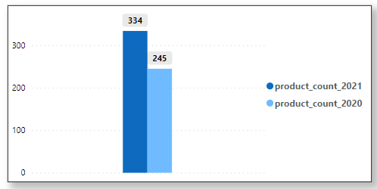
2. What is the percentage of unique product increase in 2021 vs 2020? The final output contains these fields.
1) unique_product_2020 2) unique_product_2021 3) Percentage_chg
36 % YoY chg
We observed a 36% increase in the number of unique products in AtliQ Hardware's portfolio from 2020 to 2021.
:

Slide 8
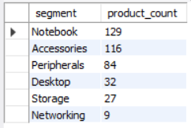
3. Provide a report with all the unique product counts for each “segment” and sort them in desecending oder of product counts. The final output contains these 2 fields. 1) segment 2) product_count
SQL Query
SELECT segment, COUNT(distinct product_code) AS product_count FROM dim_product
GROUP BY segment
ORDER BY product_count DESC;
Output

Slide 9
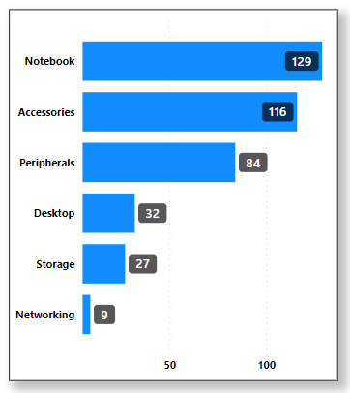
3. Provide a report with all the unique product counts for each “segment” and sort them in descending order of product counts. The final output contains these 2 fields. 1) segment 2) product_count
The notebook segment of AtliQ Hardware is performing well, but the networking segment is lagging behind. The company needs to introduce some new products in the networking segment to boost their sales.

Slide 10
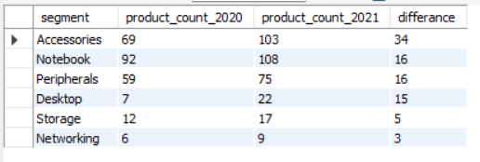
4. Follow – up: Which segment had the most increase in unique product in 2021 vs 2020? The final output contains these fields. 1) segment 2) product_count_2020 3) product_count_2021 4) difference
SQL Query
WITH cte1 AS(
SELECT segment, COUNT(distinct P.product_code) AS product_count_2020
FROM fact_sales_monthly AS S
JOIN dim_product AS P
USING (product_code)
WHERE fiscal_year = 2020
GROUP BY segment),
cte2 AS(
SELECT segment, COUNT(distinct P.product_code) AS product_count_2021
FROM fact_sales_monthly AS S
JOIN dim_product AS P
USING (product_code)
WHERE fiscal_year = 2021
GROUP BY segment)
SELECT C2.segment, product_count_2020, product_count_2021,
(product_count_2021 - product_count_2020) AS differance
FROM cte1 AS C1
JOIN cte2 AS C2
USING (segment)
ORDER BY differance DESC
Output

Slide 11
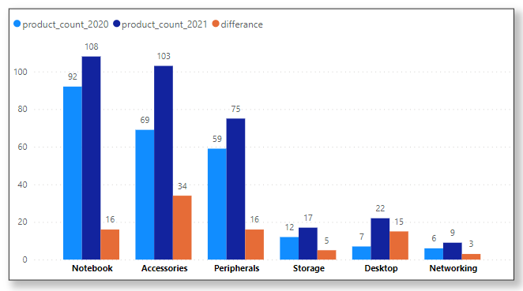
4. Follow – up: Which segment had the most increase in unique products in 2021 vs 2020? The final output contains these fields. 1) segment 2) product_count_2020 3) product_count_2021 4) difference
The notebook segment of AtliQ Hardware is performing well, but the networking segment is lagging behind. The company needs to introduce some new products in the networking segment to boost their sales.

Slide 12

5. Get the products that have the highest and lowest manufacturing costs. The final output should contain these fields, 1) product_code 2) product 3) manufacturing_cost
SQL Query
SELECT P.product_code, product, manufacturing_cost
FROM fact_manufacturing_cost AS M
JOIN dim_product AS P
USING (product_code)
WHERE manufacturing_cost = (SELECT MIN(manufacturing_cost) FROM fact_manufacturing_cost) OR
manufacturing_cost = (SELECT MAX(manufacturing_cost) FROM fact_manufacturing_cost)
ORDER BY manufacturing_cost DESC;
Output

Slide 13
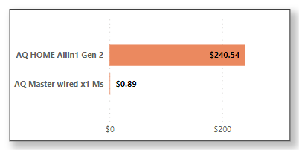
5. Get the products that have the highest and lowest manufacturing costs. The final output should contain these fields, 1) product_code 2) product 3) manufacturing_cost
The product AQ Home Allin Gen 2 has the highest manufacturing cost, while the AQ Master Wired X1 Mouse has the lowest manufacturing cost.

Slide 14
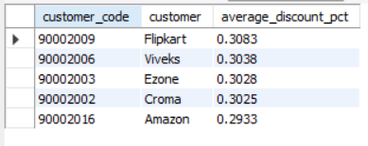
6. Generate a report which contains the top 5 customers who received an high pre_invoice_discount_pct for the “fiscal_year_2021” and in the “Indian” market, The final output contains these fields, 1) customer_code 2) customer 3) average _discount_percentage
SQL Query
SELECT C.customer_code, customer, pre_invoice_discount_pct AS average_discount_pct
FROM dim_customer AS C
JOIN fact_pre_invoice_deductions AS PID
USING (customer_code)
WHERE fiscal_year = 2021 AND market = "India"
ORDER BY average_discount_pct desc
LIMIT 5;
Output

Slide 15
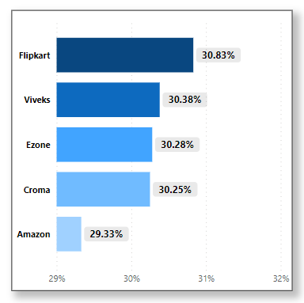
6. Generate a report which contains the top 5 customers who received an high pre_invoice_discount_pct for the “fiscal_year_2021” and in the “Indian” market, The final output contains these fields, 1) customer_code 2) customer 3) average _discount_percentage
As we have observed, Flipkart has received the highest pre-invoice discount from Atliq Hardware. This indicates the highest sales among their competitors.

Slide 16
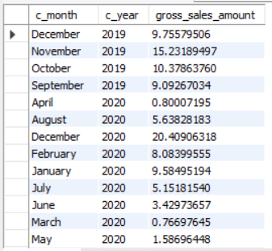
7. Get the complete report of the Gross sales amount for the customer “Atliq Exclusive” for each month. This analysis helps to get an idea of low and high performing months and take strategic decision:
The final report contain these column 1) Month 2) Year 3) gross Sale Amount
SQL Query
SELECT monthname(S.date) AS c_month,
year(S.date) AS c_year,
SUM(sold_quantity * gross_price)/1000000 AS gross_sales_amount
FROM fact_gross_price AS GP
JOIN fact_sales_monthly AS S
ON GP.product_code = S.product_code
JOIN dim_customer AS C
ON S.customer_code = C.customer_code
WHERE customer = "Atliq Exclusive"
GROUP BY c_year,c_month
ORDER BY c_year
Output

Slide 17
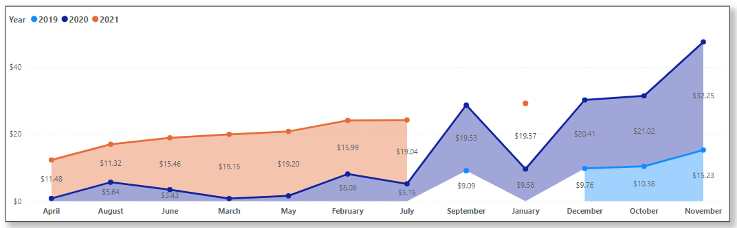
7. Get the complete report of the Gross sales amount for the customer “Atliq Exclusive” for each month. This analysis helps to get an idea of low and high performing months and take strategic decision:
The final report contain these column 1) Month 2) Year 3) gross Sale Amount
According to the data, the last four months of the year, September, October, November, and December, have been peak months for the company in terms of sales. AtliQ Hardware can introduce some products to increase sales in the summer or after year-end. Overall, sales have increased after the pandemic and remained high compared to pre-pandemic levels.

Slide 18
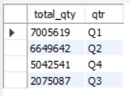
8. In which quarter of 2020, got the maximum total_sold_quantity? The final output contains these fields sorted by the total_sold_quantity, 1) Quarter 2) total_sold_quantity
SQL Query
SELECT SUM(sold_quantity) AS total_qty,
CASE
WHEN MONTH(date) IN (9,10,11) THEN "Q1"
WHEN MONTH(date) IN (12,1,2) THEN "Q2"
WHEN MONTH(date) IN (3,4,5) THEN "Q3"
ELSE "Q4"
END AS qtr
FROM fact_sales_monthly
WHERE fiscal_year = 2020
GROUP BY qtr
ORDER BY total_qty desc;
Output

Slide 19
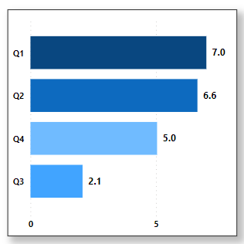
8. In which quarter of 2020, got the maximum total_sold_quantity? The final output contains these fields sorted by the total_sold_quantity, 1) Quarter 2) total_sold_quantity
For the fiscal year 2020, Q3 had the lowest number of products sold. During Q3 or summer, Atliq's product demand decreased. That's why Atliq can introduce some new outdoor products like waterproof speakers, mini fans, portable fridges, etc., to boost sales in Q3.

Slide 20
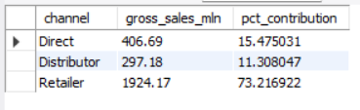
9. Which channel helped to bring more gross sales in the fiscal year 2021 and the percentage of contribution? The final output contains these fields 1) channel 2) gross_sales_mln 3) percentage
SQL Query
WITH cte1 AS (
SELECT channel,
ROUND(SUM(sold_quantity * gross_price/1000000),2) AS gross_sales_mln
FROM fact_sales_monthly AS S
JOIN fact_gross_price AS GP
ON S.product_code = GP.product_code
JOIN dim_customer AS C
ON S.customer_code = C.customer_code
WHERE S.fiscal_year = 2021
GROUP BY channel)
SELECT *,
(gross_sales_mln*100)/SUM(gross_sales_mln) OVER () AS pct_contribution
FROM cte1
Output

Slide 21
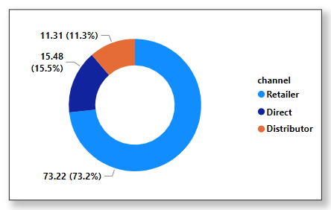
9. Which channel helped to bring more gross sales in the fiscal year 2021 and the percentage of contribution? The final output contains these fields 1) channel 2) gross_sales_mln 3) percentage
Atliq has three main distribution channels. However, the majority of their sales come from retailer outlets (73.22%), meaning brick-and-mortar stores. They could focus more on the direct channel by selling more products through Atliq Exclusive, their own store. This strategy could increase their profit margin.

Slide 22
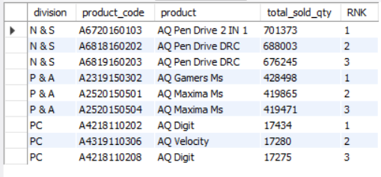
10. Get the Top 3 products in each devision that have a high total_sold_quantity in the fiscal_year 2021? The final output contains these fields, 1) division 2) product_code 3) product 4) total_sold_quantity 5) rank_order
SQL Query
WITH cte1 AS (
SELECT division, P.product_code,
product,SUM(sold_quantity) AS total_sold_qty,
rank() OVER(partition by division order by SUM(sold_quantity) DESC) AS RNK
FROM dim_product AS P
JOIN fact_sales_monthly AS S
USING (product_code)
WHERE fiscal_year = 2021
GROUP BY P.division, P.product_code, product)
SELECT * FROM cte1
WHERE RNK <= 3
Output

Slide 23
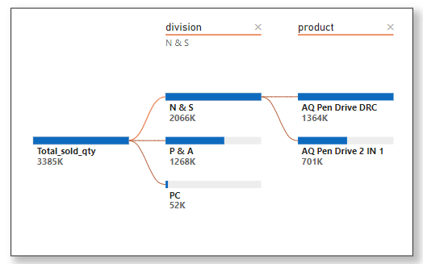
10. Get the Top 3 products in each devision that have a high total_sold_quantity in the fiscal_year 2021? The final output contains these fields, 1) division 2) product_code 3) product 4) total_sold_quantity 5) rank_order
AtliQ's highest number of products sold is in their N&S division, followed by the P&A division. Sales in their PC division are comparatively lower than in the other two divisions. They need to focus on technology and innovation to boost sales in the PC division. The PC division has a higher profit margin compared to the other divisions, so it would be more beneficial to the company if their sales increased in the PC division.

Slide 24
SUMMARY
AtliQ Hardware's overall performance in FY 2021 is good.
The company has a strong distribution network in the retail channel, but it needs to increase its sales in the e-commerce division by partnering with other giants in their local market.
AtliQ's Q1 performance is impressive, but sales decreased drastically in Q3. They need to introduce new products to increase sales in Q3 as well.

